Slide 1
Object Oriented Programming
Module Code MTS-COM-212
Prerequisite :MTS - COM-212 (Procedural Programming I)
By R.J. BANDA

Slide 2
Object Oriented Programming History
The Object-oriented programming was first introduced at MIT in the 1950’s, which gained speed in the 1970’s.
In the 1980’s Bjarne Stroustrup integrated OOP into C Language and called it C++. It was the first object-oriented language that was widely used and was successful commercially.
In 1990, James Gosling of Sun Micro Systems developed a simple version of C++ called Java and it was widely used to develop applications on internet, as Internet became a rage in those times.
For OOP interesting reading please visit: https://en.wikipedia.org/wiki/Object-oriented_programming
The Python language was developed by Guido van Rossum in 1989 and by 1990 it had the capability for Object-oriented programming.

Slide 3
So what is OOP ?
OOP is a programming paradigm based on the concept of objects, which may contain data, in the form of fields, often known as attributes and code, in the form of procedures, often known as methods.
Any Object-oriented programming language(OOP) should support the following concepts:
Encapsulation - Ability to model abstract real world objects (characteristics(attributes) and behavior (methods)) and hide unnecessary information.
Inheritance - Ability to create sub-classes from existing classes.
Polymorphism - Ability of an object to adapt the code to the type of the data it is processing.
OOP languages are Python, Java, C++, C#, Smalltalk etc.

Slide 4
Procedural Programming
A programming paradigm defines the methodology of designing and implementing programs using the key features and other building blocks of a programming language and gives you an idea of how problems are generally analysed and solved in a particular programming language.
Below are a few commonly used programming paradigms:
Procedural Programming
Object Based Programming
Object Oriented Programming

Slide 5
Procedural Programming
Procedural programming is a programming paradigm that uses a linear or top-down approach.
It is based on the concept of the procedure call.
A program consists of data and procedures that operate on the data.
Data and procedures are treated as separate entities.
It lays more emphasis on procedure than on data.
Procedures, also known as routines, subroutines, or functions, simply contain a series of computational steps to be carried out.
C programming language uses procedural programming style.
C++ and Java can also be used as a Procedural programming language with some enhanced features such as type checking, reference variables, inline functions, default arguments etc.

Slide 6
Pros and cons of Procedural programming languages
Pros :
For smaller programs the code is usually small, more readable and result oriented.
They are usually very efficient since they are written for a very specific purpose.
Cons :
Since programs are function biased they do not relate to a real life object.
When large amount of code is written inside functions, it becomes very difficult to maintain or make modifications.
Changing the way data is stored may require large amount of changes in code, making it difficult to maintain large systems.

Slide 7
Object Oriented Programming
Object-oriented Programming is a programming paradigm based on the concept of objects, which may contain data, in the form of fields, often known as attributes and code, in the form of procedures, often known as methods.
Object-oriented Programming languages are diverse, but the most popular ones are class-based, meaning that objects are instances of classes, which also determine their types. The concept of Class:
In Object-oriented programming, we use classes to represent real-world things and scenarios, and we create objects based on these classes. Definition: A class is a blueprint or design that defines the variables and the methods common to all objects of a certain kind.

Slide 8
Object Oriented Programming
The data stored in its variables are known as attributes / fields.
The code that can access this data to give the necessary output are called methods / functions .
So, we understood that a class is used to associate code with the data that it operates on.
Using a class reduces the complexity as the code increases.
An object is a specimen of a class.
An instance is a specific object created from a particular class. Creating an object from a class is called instantiation.

Slide 9
Object Oriented Programming
Object-oriented programming combines data and behavior (or
method). This is called encapsulation.
• Data hiding is the ability of an object to hide data from other
objects in the program.
• Only an object’s methods should be able to directly
manipulate its attributes.
• Other objects are allowed to manipulate an object’s attributes
via the object’s methods.
• This indirect access is known as a programming interface.

Slide 10
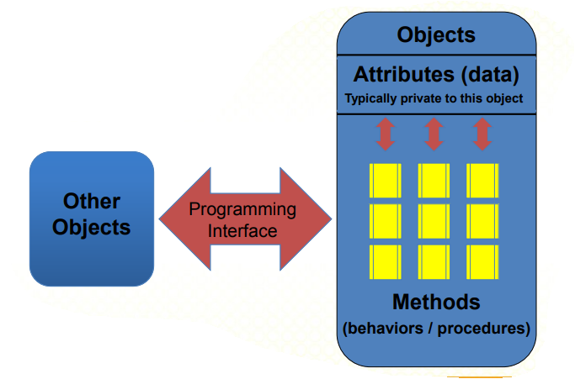
Object Oriented Programming

Slide 11
Benefits of Object-oriented Programming
• Save development time (and cost) by reusing code
– once an object class is created it can be used in other applications
• Easier debugging
– classes can be tested independently
– reused objects have already been tested

Slide 12
Object Based Programming
Object based programming is a programming paradigm that implements some features of Object-oriented programming but not all. In Object based programming, data and its associated meaningful functions are enclosed in one single entity called Class. Classes enforce information hiding and abstraction thereby separating the implementation details. In Object based programming, whenever there is any change in the definition of type, user interface remains unaffected generally.

Slide 13
Object Based Programming
Object based programming can be treated as a subset of Object-oriented programming as it implements some of the features implemented by Object-oriented programming like information hiding, abstraction, classes, function overloading, etc. Object based programming paradigm does not implement Inheritance and Polymorphism. Java Script, Visual Basic are Object based programming languages.

Slide 14
Advantages of Object Based Programming
It overcomes most of the shortcomings of Procedural programming
It localizes changes and hides implementation details from user
It supports user-defined types
Implements information hiding and abstraction
However, Object based programming suffers from one major limitation and that is its inability to represent real world relationships that exist among objects.
OOP offers all the features of Object based programming and overcomes its limitation by implementing Inheritance.

Slide 15
Understanding OOPS Concepts
Procedural programming emphasizes on procedures (functions/methods) to be implemented
Object-oriented programming (OOP) approach views a problem in terms of objects or entities involved rather than the procedures.
Therefore, objects are key to understanding Object-oriented programming.

Slide 16
The Concept of Object
Definition: An object is a software bundle of variables and related methods.
We can look around and find many examples of real-world objects such as: our mobile phone, car, our computer, our clock,..etc.
All these real-world objects share two characteristics: state and behavior.
For example; mobiles have state (model name, colour, battery saver, switched on/off) and behaviour (call ringing, playing music, recording videos).
Software objects imitate real-world objects in that they too have state and behaviour.
The software object maintains its state in one or more variables represented by its data and implements its behaviour with functions (often called as methods).

Slide 17
The Concept of object cont…
These variables are conventionally known as instance variables because they contain the state for a particular object (called as instance)
These methods are conventionally known as instance methods because they change the state of a particular object.
In Object-oriented programming, an object represents an entity that can store data and has its interface with outside world through methods.
Now, a class can also be described as "a representation of characteristics and behaviour of the same category (or family) of objects.“
Hence, an object, Generic Student can be considered as an instance of a class called Student.

Slide 18
Encapsulation Concept
It describes the idea of bundling data and methods that work on the data within one unit restricting access to some of the object’s components (variables and methods)
A class is an example of encapsulation as it binds together data and its associated functions under one unit.
Advantages:
It can prevent the accidental modification or misuse of data by an outside entity.
It allows programmers better control of how data flows in their programs.
Encapsulation = Abstraction + Information Hiding

Slide 19
OOP Concepts
Abstraction is used as a technique to identify all the essential characteristics and behaviour of an object and to omit those aspects that are unimportant.
Information Hiding is hiding all the unnecessary information (like implementation details etc.) from outside entities.
A class groups its members into three sections as private, protected and public.
The private and protected members remain hidden from outside world i.e., a class enforces data hiding.
The outside world is given only the essential and necessary information through public members, rest of the things remain hidden which is called abstraction.

